Slide 1
Software Engineering CS20006
Lecture 10
Activity Diagrams

Slide 2
Lecture #10
What is an activity diagram?
Example: Student Enrollment in IIT (SEIIT)
Activity diagram for a use case in SEIIT
Basic components in an activity diagram and their notations
Managing the large activity diagram: Swim Lane
Activity diagram vs. Flow chart
Communication diagrams

Slide 3
What is an Activity Diagram?
Activity diagrams represent the dynamic (behavioral) view of a system
Activity diagrams are typically used for business (transaction) process modeling and modeling the logic captured by a single use-case or usage scenario
Activity diagram is used to represent the flow across use cases or to represent flow within a particular use case
UML activity diagrams are the object oriented equivalent of flow chart and data flow diagrams in function-oriented design approach
Activity diagram contains activities, transitions between activities, decision points, synchronization bars, swim lanes and many more…

Slide 4
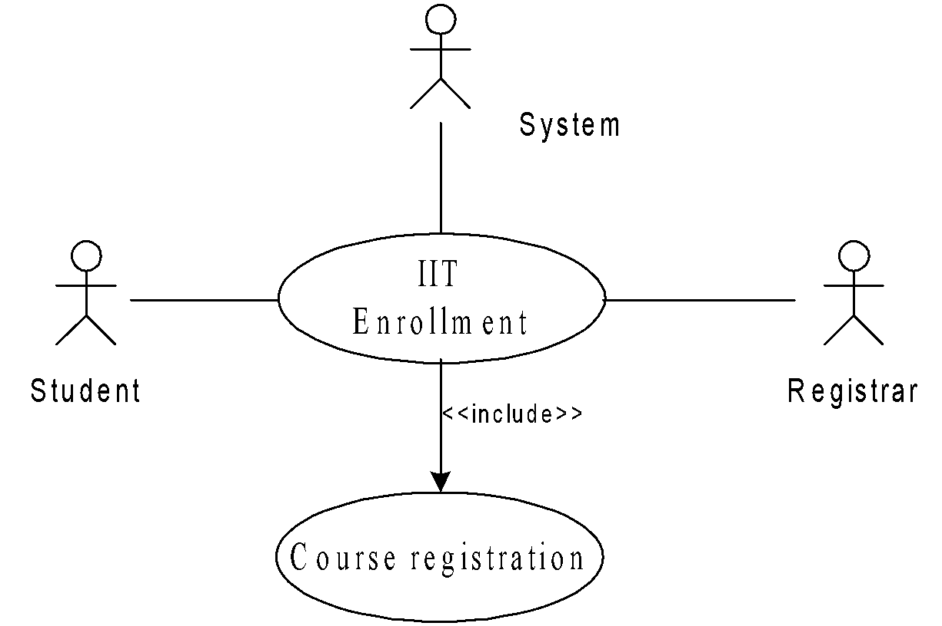
Student Enrollment in IIT (SEIIT)

Slide 5
SEIIT System
Here different activities are:
Received enrollment form filled by the student
Registrar checks the form
Input data to the system
System authenticate the environment
Pay fees by the student
Registrar checks the amount to be remitted and prepare a bill
System acknowledge fee receipts and print receipt
Hostel allotment
Allot hostel
Receive hostel charge
Allot room
Medical check up
Create hostel record
Conduct medical bill
Enter record
Issue library card
Issue identity card

Slide 6
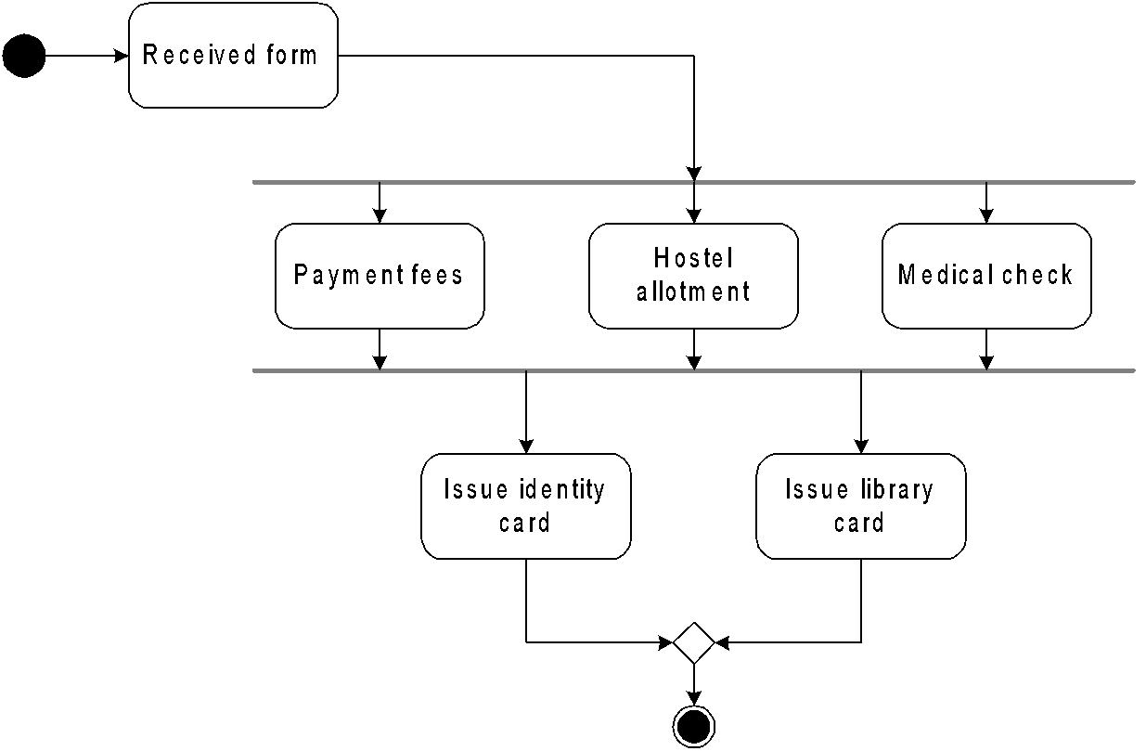
Activity Diagram for the Use Case in SEIIT

Slide 7

Basic Components in an Activity Diagram
Initial node
The filled circle is the starting point of the diagram
Final node
The filled circle with a boarder is the ending point. An activity diagram can have zero or more activity final state.
Activity
The rounded circle represents activities that occur. An activity is not necessarily a program, it may be a manual thing also
Flow/ edge
The arrows in the diagram. No label is necessary

Slide 8
Basic Components in an Activity Diagram
Fork
A black bar ( horizontal/vertical ) with one flow going into it and several leaving it. This denotes the beginning of parallel activities
Join
A block bar with several flows entering it and one leaving it. this denotes the end of parallel activities
Merge
A diamond with several flows entering and one leaving. The implication is that all incoming flow to reach this point until processing continues

Slide 9
Basic Components in an Activity Diagram
Difference between Join and Merge
A join is different from a merge in that the join synchronizes two inflows and produces a single outflow. The outflow from a join cannot execute until all inflows have been received
A merge passes any control flows straight through it. If two or more inflows are received by a merge symbol, the action pointed to by its outflow is executed two or more times

Slide 10
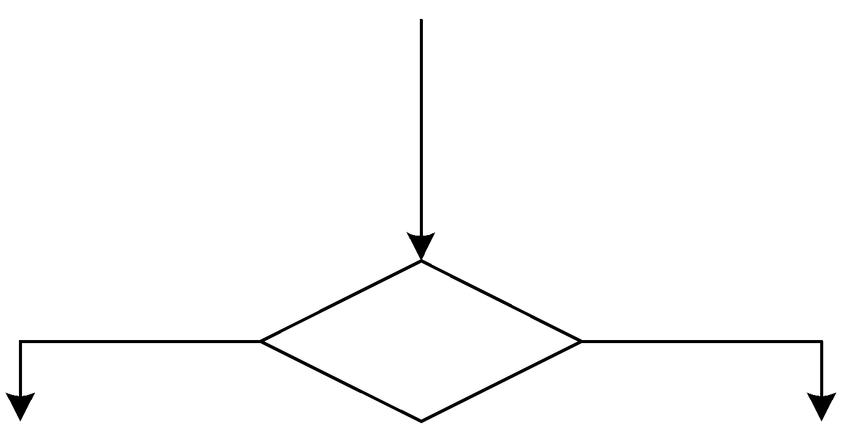

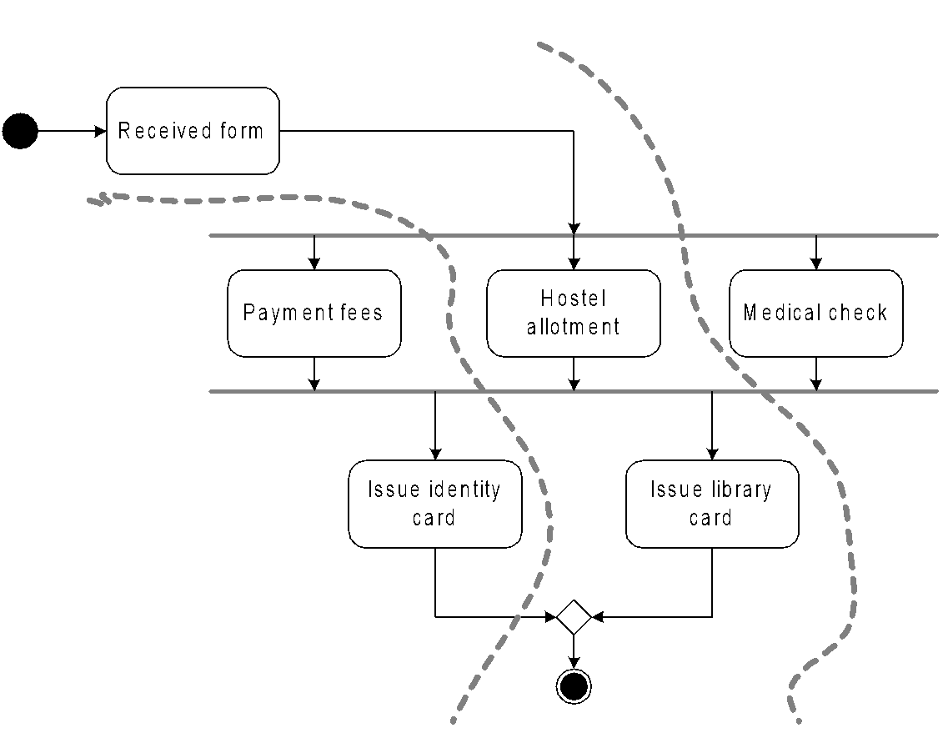
Basic Components in an Activity Diagram
Decision
A diamond with one flow entering and several leaving. The flow leaving includes conditions as yes/ no state
Flow final
The circle with X though it. This indicates that Process stop at this point
Swim lane
A partition in activity diagram by means of dashed line, called swim lane. This swim lane may be horizontal or vertical

Slide 11
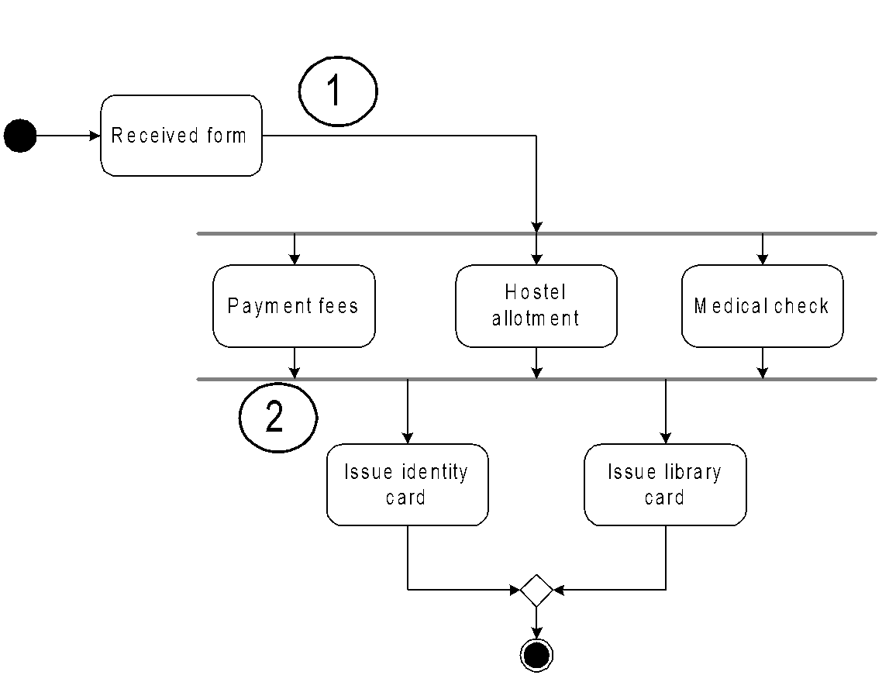
Detailed Activity Diagram of SEIIT

Slide 12
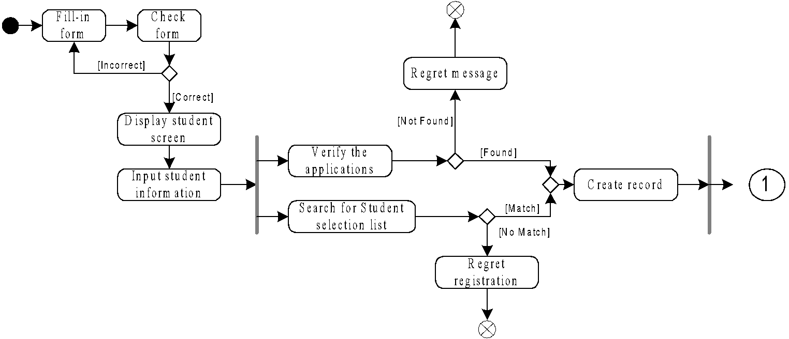
Detailed Activity Diagram of SEIIT

Slide 13
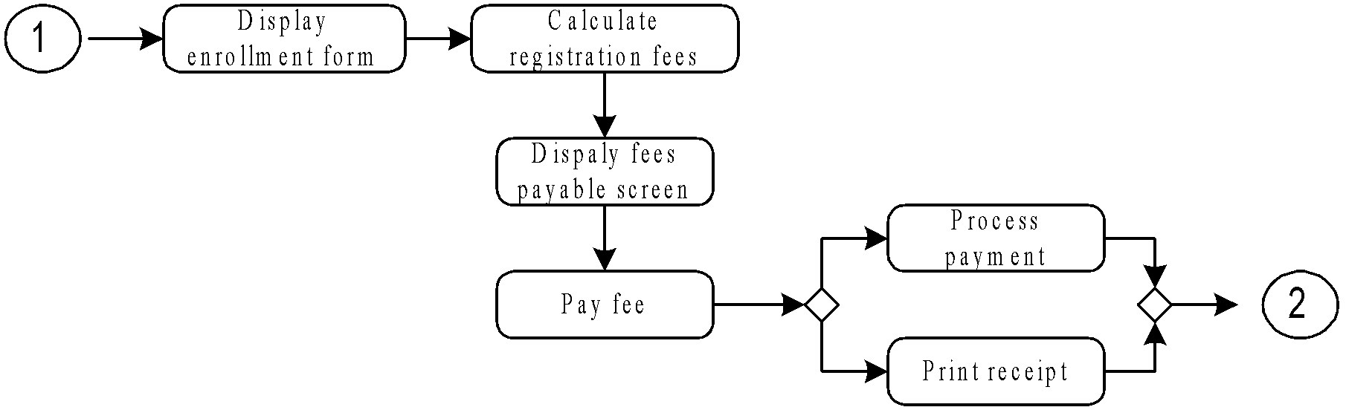
Detailed Activity Diagram of SEIIT

Slide 14
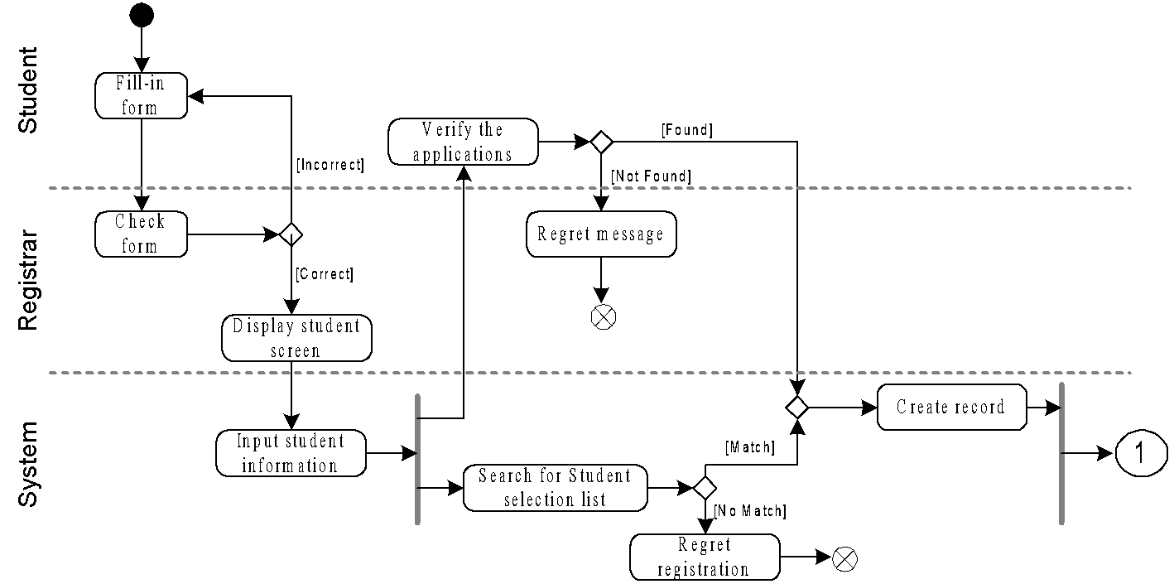
Activity Diagram of SEIIT with Swim Lane

Slide 15
Some more features in Activity Diagrams

Slide 16
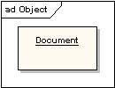
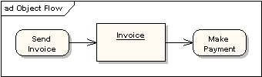
Object and Object Flow
An object flow is a path along which objects can pass. An object is shown as a rectangle
An object flow is shown as a connector with an arrowhead denoting the direction the object is being passed.

Slide 17

Input and Output Pin
An object flow must have an object on at least one of its ends. A shorthand notation for the above diagram would be to use input and output pins

Slide 18
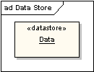
Data Store
A data store is shown as an object with the «datastore» keyword

Slide 19
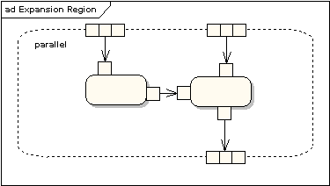
Expansion Region
An expansion region is a structured activity region that executes multiple times. Input and output expansion nodes are drawn as a group of three boxes representing a multiple selection of items. The keyword iterative, parallel or stream is shown in the top left corner of the region

Slide 20
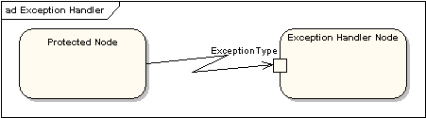
Exception Handling
Exception Handlers can be modeled on activity diagrams as in the example below

Slide 21
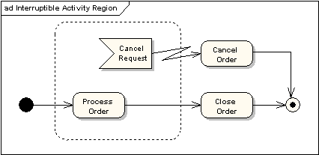
Interruptible Activity Region
An interruptible activity region surrounds a group of actions that can be interrupted. In the very simple example below, the Process Order action will execute until completion, when it will pass control to the Close Order action, unless a Cancel Request interrupt is received which will pass control to the Cancel Order action

Slide 22
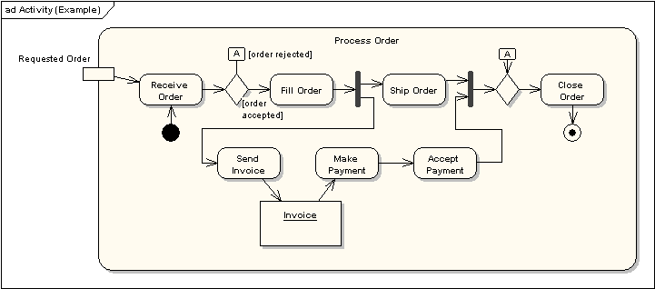
An Example
Identify the business logic in the activity diagram shown below

Slide 23
Importance of Activity Diagram
An activity diagram can depict a model in several ways
It can also depicts “Basic course of action” as well as “detailed courses”
Activity diagram can also be drawn that cross several use cases, or that address just a small portion of use case
Activity diagrams are normally employed in business process modeling. This is carried out during the initial stages of requirement analysis and specification
Activity diagrams can be very useful to understand the complex processing activities involving many components
The activity diagram can be used to develop interaction diagrams which help to allocate activities to classes

Slide 24
Problems to Ponder
How activity diagram related to flow chart? How it defers from flow chart?
How methods in classes and activities can be correlated?

Slide 25
Problems to Ponder
Draw the activity diagrams for
Library Information System
Bank ATM

Slide 26
Collaboration Diagram

Slide 27
What is a Collaboration diagram?
Basic components in any Collaboration diagram and their notations
Sequence diagram vs. Collaboration diagram

Slide 28
What is a Collaboration Diagram
The second form of the interaction diagram is the collaboration diagram
A collaboration diagram shows both the structural and behavioral aspects, explicitly.
The structural aspect of a collaboration diagram consists of object and the links existing between them
The behavioral aspect is described by a set of messages exchanged among the different collaborations
In the collaboration diagram, an object is also called collaborator

Slide 29
Basic of Collaboration Diagram
A collaboration diagram contains the following things:
Objects drown as rectangles
Links between the objects shown as lines connecting as lines connecting the linked objects
Messages shown as text and an arrow that points from a client object to a respondent object
Let us consider an example of a collaboration diagram in Process Order use case of the OLP system

Slide 30
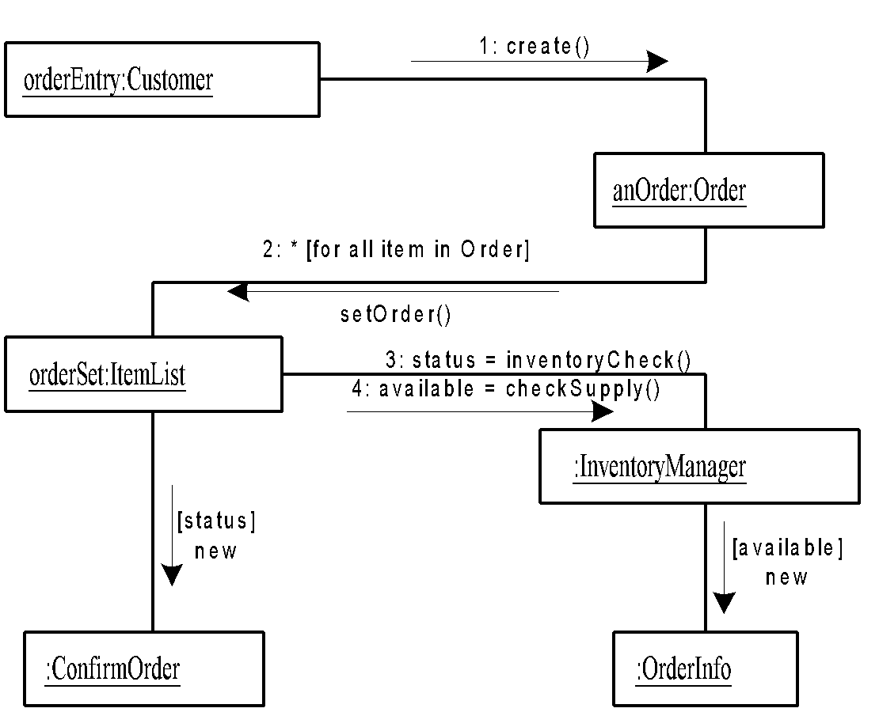
Example: Collaboration Diagram

Slide 31
Note: Collaboration Diagram
In collaboration diagram, the sequence indicated by numbering the messages
Here, we have used the simple numbering scheme. The UML also allows decimal scheme [as in DFD] to document the hierarchical messaging

Slide 32
Sequence Diagram vs. Collaboration Diagrams
There are two basic features by which Sequence diagram differs from the Collaboration diagram
Object life time
In sequence diagram, there is a object line represent the existence of an object over a period of time. There is no object life time in collaboration diagram
Focus of control
In sequence diagram, there is the focus of control to show the period of time during which object is performing an action. There is no focus of control in collaboration diagram

Slide 33
Sequence Diagram vs. Collaboration Diagrams
Sequence diagram provides a way to look at scenario in a time based order – what happen after what etc. Customer easily can read and understand this type of diagram. Hence, they are very useful in the early analysis phases as well as in coding phase
Collaboration diagram tend to provide the big picture for a scenario since the collaborations are organized around the object links to one another. These diagrams seem to be used more in the design phase of development

Slide 34
Problems to Ponder
Obtain sequence diagrams for the following
Heap sort
Binary Search
Dinning Philosophers problem
Tower of Hanoi problem
“Login Verification” procedure
All use cases in OLP
Given a sequence diagram draw a collaboration diagram and vice-versa

